Slide 1

Cybersecurity Incident, Vulnerability and Response Workflow Platform
COURSE NAME: Programming in java
COURSE CODE: CSA0918
FACUITY NAME: Dr . S . Padmakala
PRESENTED BY
P ROHINI(192524147)
S SHAINEY(192511378)

Slide 2
Presentation OutliNE
Abstract
Introduction
Problem statement
Objective
Literature review
Architecture Diagram
Module 1
Module 2
Future enhancement
Conclusion
References

Slide 3
ABTRACT
The Cybersecurity Incident, Vulnerability and Response Workflow Platform is a web-based security management system designed to detect cyber incidents, identify vulnerabilities, and automate response activities. The platform continuously monitors security logs, analyzes suspicious activities, prioritizes incidents based on risk, and generates alerts and reports. It helps organizations improve security operations, minimize damage, and maintain a secure digital environment.

Slide 4
INTRODUCTION
Cybersecurity protects computers, networks, applications, and data from cyber attacks such as hacking, malware, phishing, and ransomware.
Organizations face thousands of security alerts daily, making manual monitoring and response difficult.
This project provides a centralized platform to detect cyber incidents, identify vulnerabilities, and automate the response workflow.
It helps security teams prioritize threats, respond quickly, and reduce the risk of data breaches.
The platform also generates real-time dashboards and reports for effective security monitoring and management.

Slide 5
PROBLEM STATEMENT
Existing security systems generate a large number of alerts, making it difficult to identify critical threats.
Manual incident detection and response consume time and may delay security actions.
Organizations face challenges in identifying and managing system vulnerabilities effectively.
There is no centralized platform to monitor incidents, track vulnerabilities, and automate the response process.
Delayed responses can lead to data breaches, financial loss, and service disruption.

Slide 6
Objective
To detect cybersecurity incidents in real time.
To identify vulnerabilities in systems and networks.
To automate the incident response workflow.
To reduce incident response time and improve security.
To generate real-time dashboards and security reports.

Slide 7
LITERATURE REVIEW
AUTHORS | PUBLICATION YEAR | TITLE OF THE YEAR | MERITS / DEMERITS
Michael Bitzer et al. | 2023 | Managing the Inevitable: A Maturity Model to Establish Incident Response Management Capabilities | Improves incident response Does not include automated vulnerability management.
Gulay et al. | 2024 | Cybersecurity Incident Prioritization | Helps prioritize security incidents. Does not automate the complete response process.
Ziegler et al. | 2025 | Security Incident Response Process | Improves incident response management. Limited to specific security systems.

Slide 8
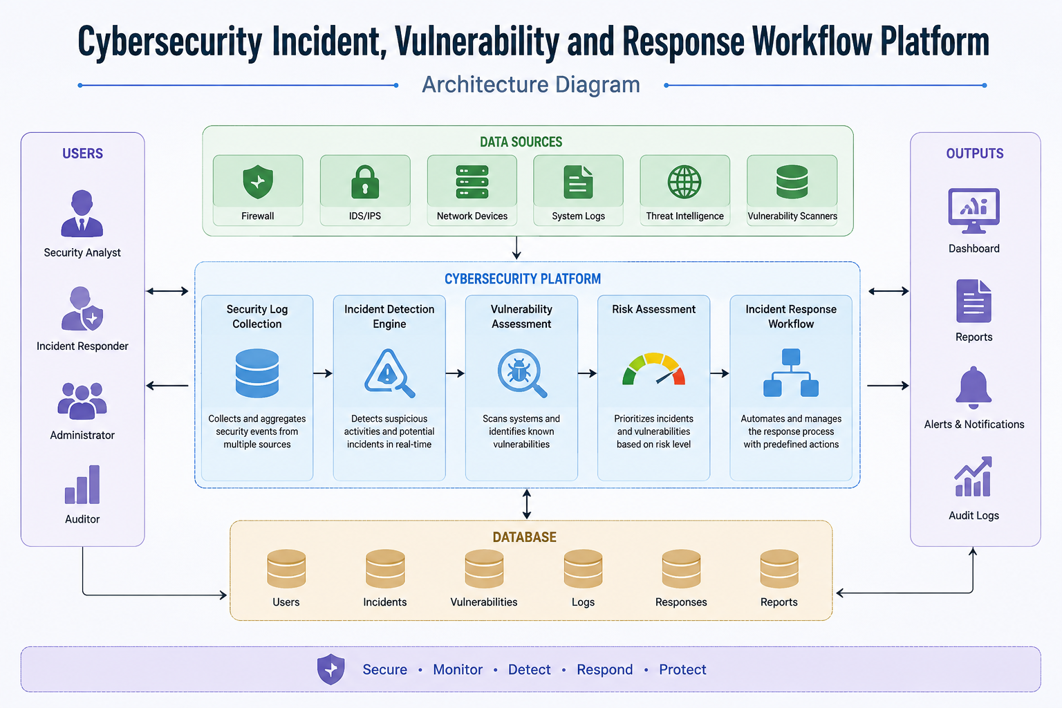
ARCHITECTURE DIAGRam

Slide 9

MODULE 1:Incident Detection & Vulnerability Assessment
Collect security logs.
Monitor network activities.
Detect suspicious behavior.
Scan systems for vulnerabilities.
Assign risk levels (Critical, High, Medium, Low).
Generate incident alerts.

Slide 10

MODULE 2:Response Workflow & Reporting
Create incident tickets automatically.
Notify security administrators.
Track incident status.
Store incident history.
Generate dashboards and reports.
Maintain audit logs.

Slide 11
FUTURE ENHANCEMENT
AI-based threat prediction.
Machine Learning anomaly detection.
Cloud deployment.
Mobile application support.
Blockchain audit logs.
Automatic patch management.
Integration with SIEM and SOAR platforms.

Slide 12
CONCLUSION
The Cybersecurity Incident, Vulnerability and Response Workflow Platform provides an efficient solution for detecting cyber threats, identifying vulnerabilities, and automating security operations. By integrating monitoring, risk assessment, and response management into a single platform, it improves organizational security, reduces response time, and supports better decision-making.

Slide 13
REFERENCES
M. Bitzer et al., “Managing the Inevitable: A Maturity Model to Establish Incident Response Management Capabilities,” Computers & Security, vol. 128, 2023.
S. Hays and J. White, “Employing LLMs for Incident Response Planning and Review,” arXiv preprint arXiv:2403.01271, Mar. 2024.
A. Gulay and L. Maglaras, “Alignment of Cybersecurity Incident Prioritisation with Incident Response Management Maturity Capabilities,” arXiv preprint arXiv:2410.02259, Oct. 2024.
V. Minkevics and J. Grabis, “A Capability-Driven Automated Cybersecurity Monitoring and Response System,” Frontiers in Computer Science, vol. 7, 2025.
N. Shimizu and M. Hashimoto, “Vulnerability Management Chaining: An Integrated Framework for Efficient Cybersecurity Risk Prioritization,” arXiv preprint, 2025.

Slide 14
THANK YOU

